Slide 1

AI-Hack Competition 2022 CHILD LOCATION TRACING MODEL FOR DAYCARE CENTERS
Group Members
Elizabeth Mutua:- Kenya
Fred sangoluche:- Gambia
Lameck Amugongo:- Namimbia
Benson Mwaura:-Kenya

Slide 2

Background
People living in urban areas within Africa require domestic workers to take care of their children.
Those without domestic workers take their children to daycares
Modern daycares have software's to manage the operations of the centers but do not have an application to track the mobility of children within the center
This has resulted to children walking out the day care and getting lost or stolen
For this reason, we develop a child location tracing model to be able to track and identify the location of a child.
Upon a child crossing a certain boundary, an alarm sounds

Slide 3
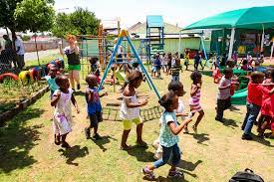
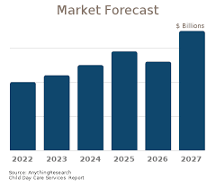
Problem Statement

Slide 4
Framework

Slide 5
References

Slide 6
Questions and discussion
END

